Slide 1



PRESENTATION
KAGGLE CHALLENGE : PREDICTING CYCLIST TRAFFIC IN PARIS
SCHROEDER NICOLAS, BENSLIMANE MOHAMED (HTTPS://GITHUB.COM/SCHRONIC/PREDICTING_BIKE_TRAFFIC)

Slide 2

SUMMARY
◉ Exploratory data analysis EDA ◉ Feature Engineering and Data Preprocessing
◉ Model Pipeline ◉ Model Evaluation
◉ Conclusion
◉ CASE PRESENTATION
The City of Paris's open data initiative provides a dataset related to bike usage: it contains data from bike counters across the city. The task is to use this data, along with any external datasets and to forecast the log-transformed bike count (log_bike_count). The problem statement calls for a supervised regression machine learning approach, more specifically time series forecasting. Given this fact, in our analysis, as well as our feature engineering, we focused specifically on variable features, so features that have the potential to change over time (such as weather or date related data).

Slide 3
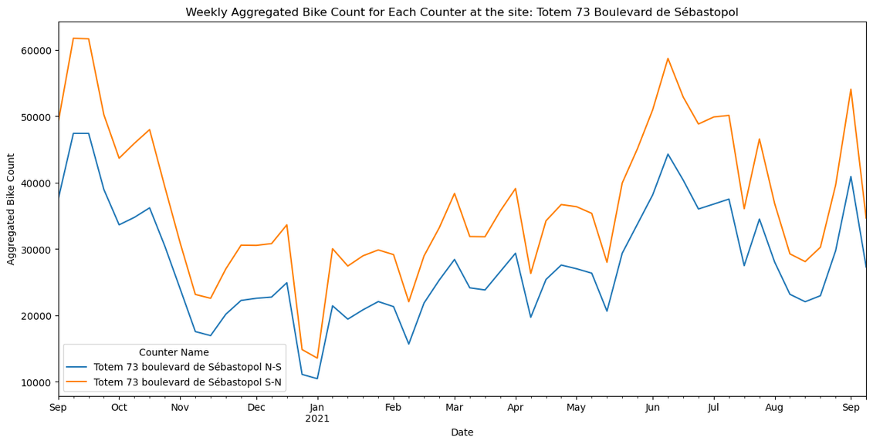
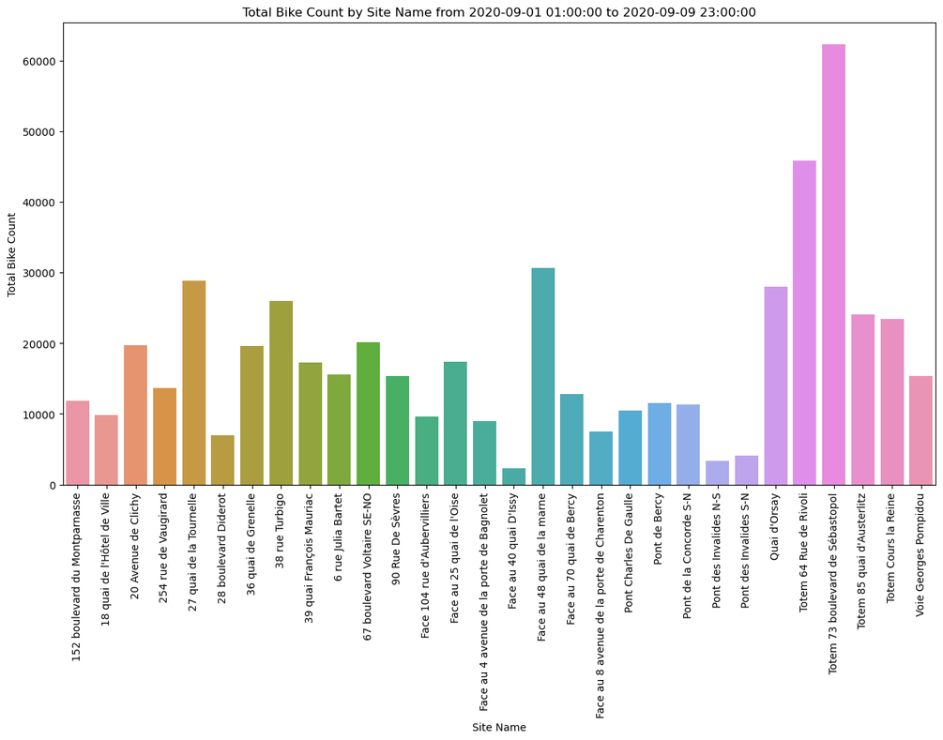
◉ EXPLORATORY DATA ANALYSIS (1/3)
DISCOVERY AND VISUALIZATION OF OUR FIRST DATASET : TRAIN.PARQUET
FIG 1: DISCOVERING OUR FEATURES
THROUGH THE HEAD OF THE GIVEN
DATASET
FIG 2: EXAMPLARY WEEKLY AVERAGED BIKE COUNT
FIG 3: TOTAL BIKE COUNT PER COUNTER

Slide 4
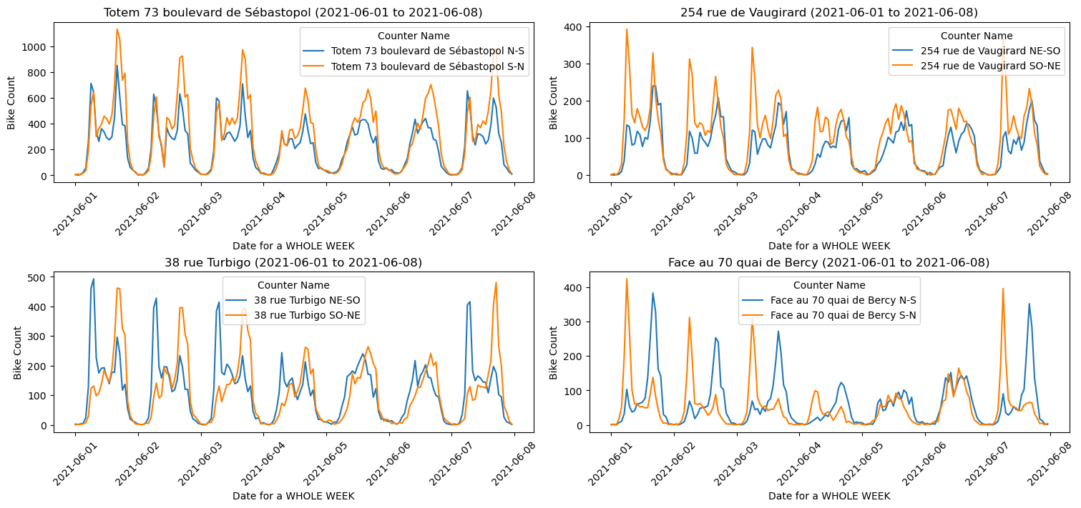
◉ EXPLORATORY DATA ANALYSIS (2/3)
SKEWED DISTRIBUTION OF THE TARGET VARIABLE
These two graphs indicate that the bike_count data is highly skewed to the right, with a large number of counts close to zero and few counts reaching higher values.
FIG 5: EXAMPLARY WEEKLY COUNT OF BIKE RIDES
FIG 5: EXAMPLARY DAILY COUNT OF BIKE RIDES
WHY SHOULD WE CHANGE THE TARGET ?
In theory, the choice of ML models are significantly impacted by the skewed distribution of the initial target variable, for example, if the original data is skewed, some models may not perform well in theory, and more robust or non-parametric models might be needed. We solve this issue by using `log_bike_count` as the target variable.

Slide 5
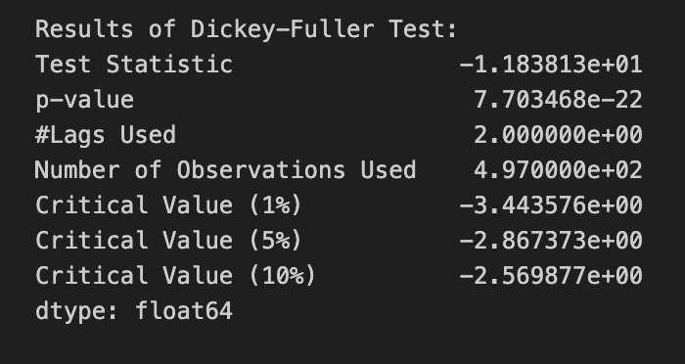
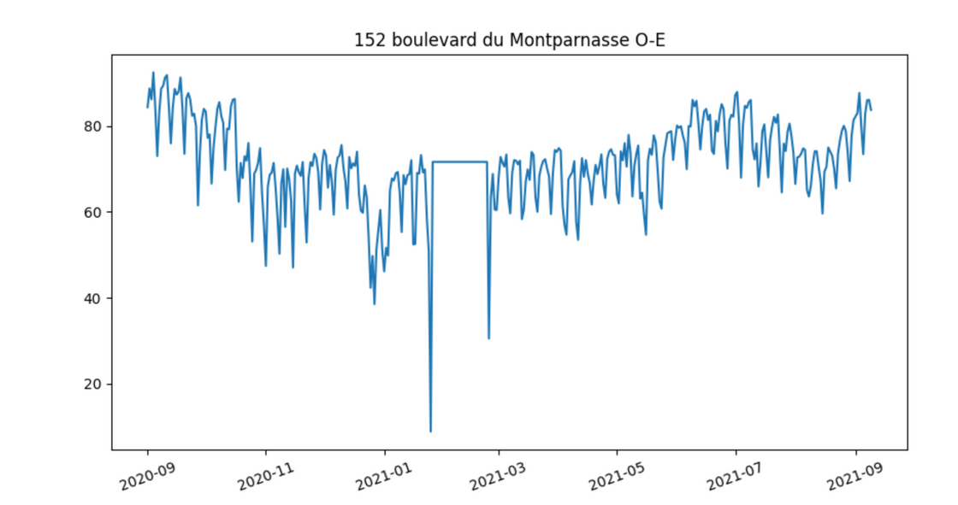

◉ EXPLORATORY DATA ANALYSIS (3/3)
THE STATIONARITY OF THE NEW TARGET
Our new target is stationary !
Why is this finding important and beneficial?
(1) Consistency in Mean and Variance
(2) Long-term Forecasting
FIG 8: POSSIBLE OPTION TO REPLACE THE NULL VALUES BY THE MEAN OF THE TARGET FOR THE WHOLE COUNTER
FIG 7: DICKEY FULLER TEST
HANDLING NULL VALUES
In our dataset, while there are no explicit missing values, there's a significant portion (about 1%) of values for 'log_bike_count' that are zero, throughout stretches of over a day, for certain counters,.
(1) Replace them by the mean for each counter
(2) Predict them using a model to estimate the missing values
(3) Not doing anything
4) Deleting them
4 SOLUTIONS

Slide 6
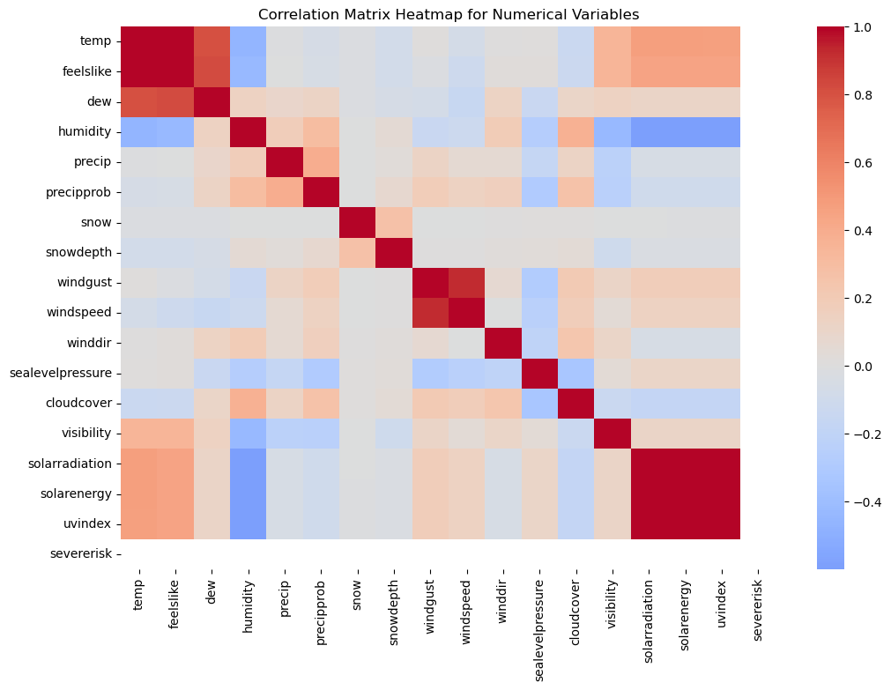
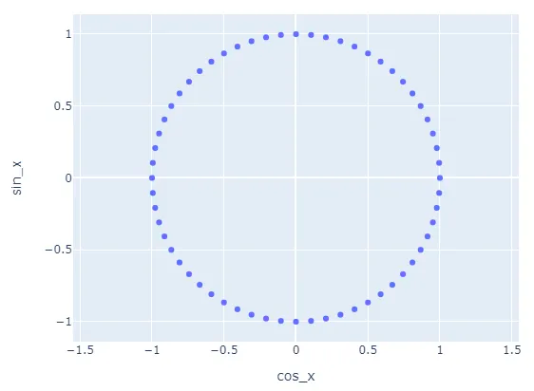
◉ FEATURE ENGINEERING AND DATA PREPROCESSING
LET’S FOCUS ON THE FEATURE SELECTION AND DATA CLEANING ON THE NEW PARIS WEATHER DATASET
The external_data.csv file contained weather data only at three hour granularity, we decided to find our own dataset with more granular data, as the disparity in data resolution could potentially result in misaligned insights and, as a consequence, less accurate predictions.
FEATURE TRANSFORMATION, CONSTRUCTION, ENCODING and Merging our final dataset
In terms of date data we went a little further engineering a number of additional features. For one we split up the datetime column into its components, as we already done in the starter kit. Features we constructed with OneHot Encoding in addition to these are: Rush Hour (Binary) , Covid Lockdown (Binary), Bank Holiday (Binary) School Holiday (Binary), Weekday (Numeric), Workday (Binary)
FIG 11: HEATMAP FOR THE NEW WEATHER DATASET
FIG 13: VISUAL INTUITION FOR THE 2 DIMENSIONAL ENCODING OF CYCLIC FEATURES

Slide 7
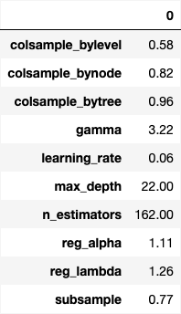
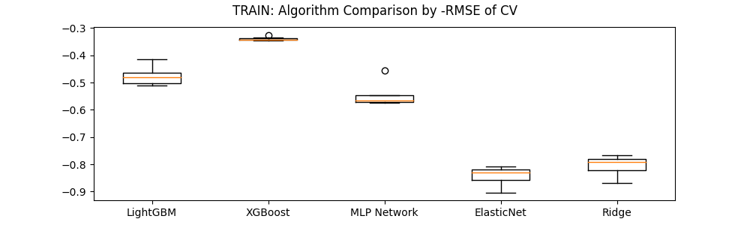
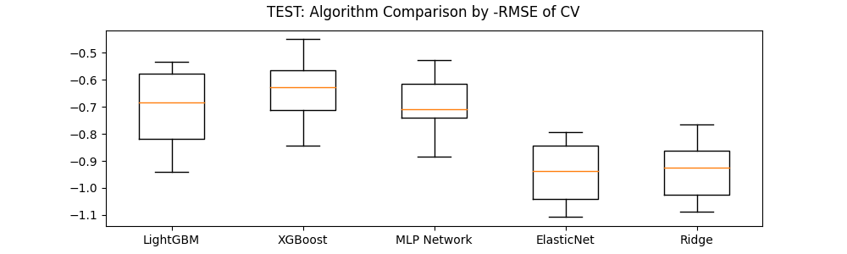
◉ MODEL PIPELINE
MODEL SELECTION RATIONALE
In this project, we evaluated a range of models, including LightGBM, XGBoost, MLP Network, ElasticNet, and Ridge Regression, due to their proven applicability in time series forecasting. We decided against auto regressive models, a popular choice for timeseries prediction, as the data exhibited significant non-linear patterns
HYPERPARAMETERS TUNING AND CROSS-VALIDATION STRATEGY
FIG 14: TRAIN CROSS VALIDATION RMSE DISTRIBUTION ACROSS MODELS.
FIG 13 : HYPERPARAMETER OUTPUT AFTER CROSSVALIDATION FOR BEST PERFORMING XGBOOST REGRESSOR
FIG 15: TEST CROSS VALIDATION RMSE DISTRIBUTION ACROSS MODELS.

Slide 8
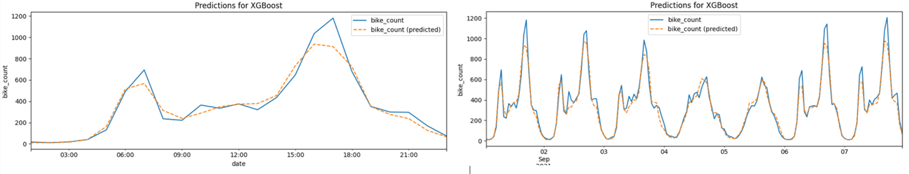

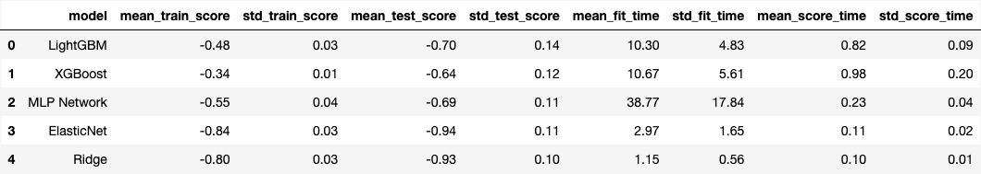
◉ MODEL EVALUATION
THE DATASET WITH REMOVED NAN VALUES IN THE TARGET VARIABLE OUTPERFORMED THE COMPLETE SET. THE XGBOOST MODEL EMERGED AS THE BEST PERFORMER (RMSE 0.64), CLOSELY FOLLOWED BY THE LIGHTGBM (RMSE 0.70) and MLP Network (RMSE 0.69) model.
FIG 15 & 16: EXAMPLARY ACTUAL VS PREDICTED VALUES ON A DAILY (WEEKLY) BASIS.
XGBOOST
LIGHTGBM
MLP NETWORK

Slide 9
CONCLUSION
Our analytical efforts in this project have indicated that models adept at handling complex, non-linear relationships—specifically XGBoost, LightGBM, and MLP Network—outperform those based on more traditional statistical approaches in predicting bike ridership.
While we have worked extensively on the issue of overfitting data, our efforts have only gotten us so far as the issue continues to persist. The project underscored the importance of meticulous feature selection. The decision to remove NaN values and unrelated data, without predictive significance, proved as crucial decisions. This work has highlighted the delicate balance between model complexity and interpretability, especially when juxtaposed against simpler models like Ridge regression, which, despite their modesty, maintain relevance in understanding the data's underlying structure.

Slide 10
THANK YOU
REFERENCES AND FULL CODE
https://github.com/schronic/predicting_bike_traffic

